Slide 1


Lecture 9:
Remote Resources
CoTaPP: Computational Thinking and
Programming with Python
All icons by: https://www.flaticon.com/

Slide 2


Midterm

Slide 3
Previous lecture

Slide 4
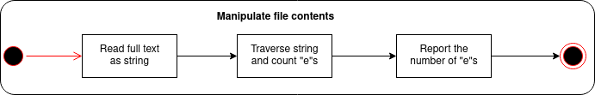
Previous lecture

Slide 5
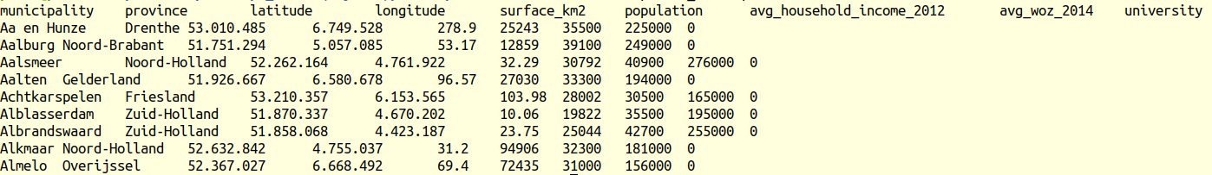
Previous lecture

Slide 6
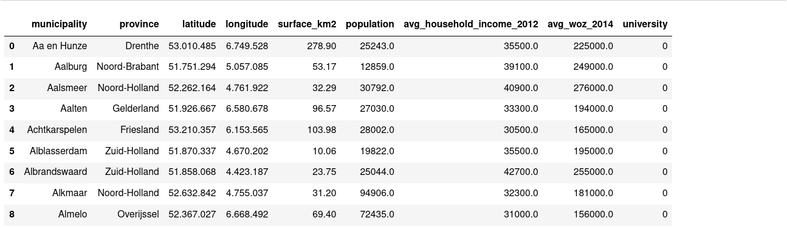
Previous lecture

Slide 7
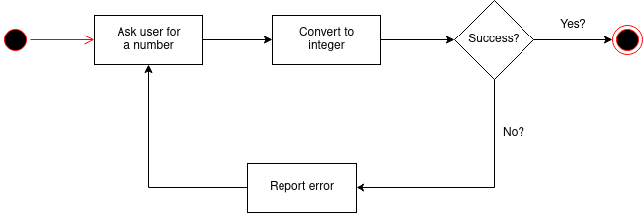
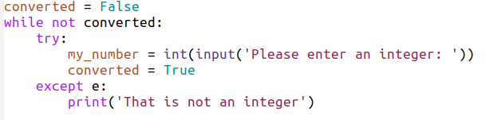
Previous lecture

Slide 8
Today’s lecture

Slide 9
Today’s lecture
WWW

Slide 10
Today’s lecture

Slide 11

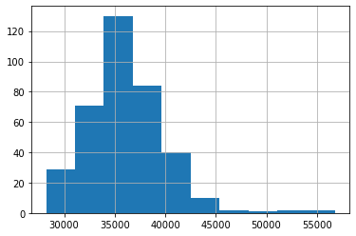
Example
You want to analyze the average household income by municipality in NL
Amsterdam 31400
Amsterdam 31400
Delft 32100
Epe
Zeist 39700

Slide 12
Example
You want to analyze the average household income by municipality in NL
Amsterdam 31400
Amsterdam 31400
Delft 32100
Epe
Zeist 39700

Slide 13
Accessing Remote Resources

Slide 14
Accessing Remote Resources
WWW

Slide 15
Accessing Remote Resources
WWW
Where is the data?

Slide 16
URL
scheme://host:port/path

Slide 17
URL
scheme://host:port/path
http://localhost:8888/tree
http://itsthisforthat.com/

Slide 18
URL
scheme://host:port/path
http://localhost:8888/tree
http://itsthisforthat.com/

Slide 19
URL
scheme://host:port/path
http://localhost:8888/tree
http://itsthisforthat.com/

Slide 20
URL
scheme://host:port/path
http://localhost:8888/tree
http://itsthisforthat.com/

Slide 21
URL
scheme://host:port/path
http://localhost:8888/tree
http://itsthisforthat.com/

Slide 22
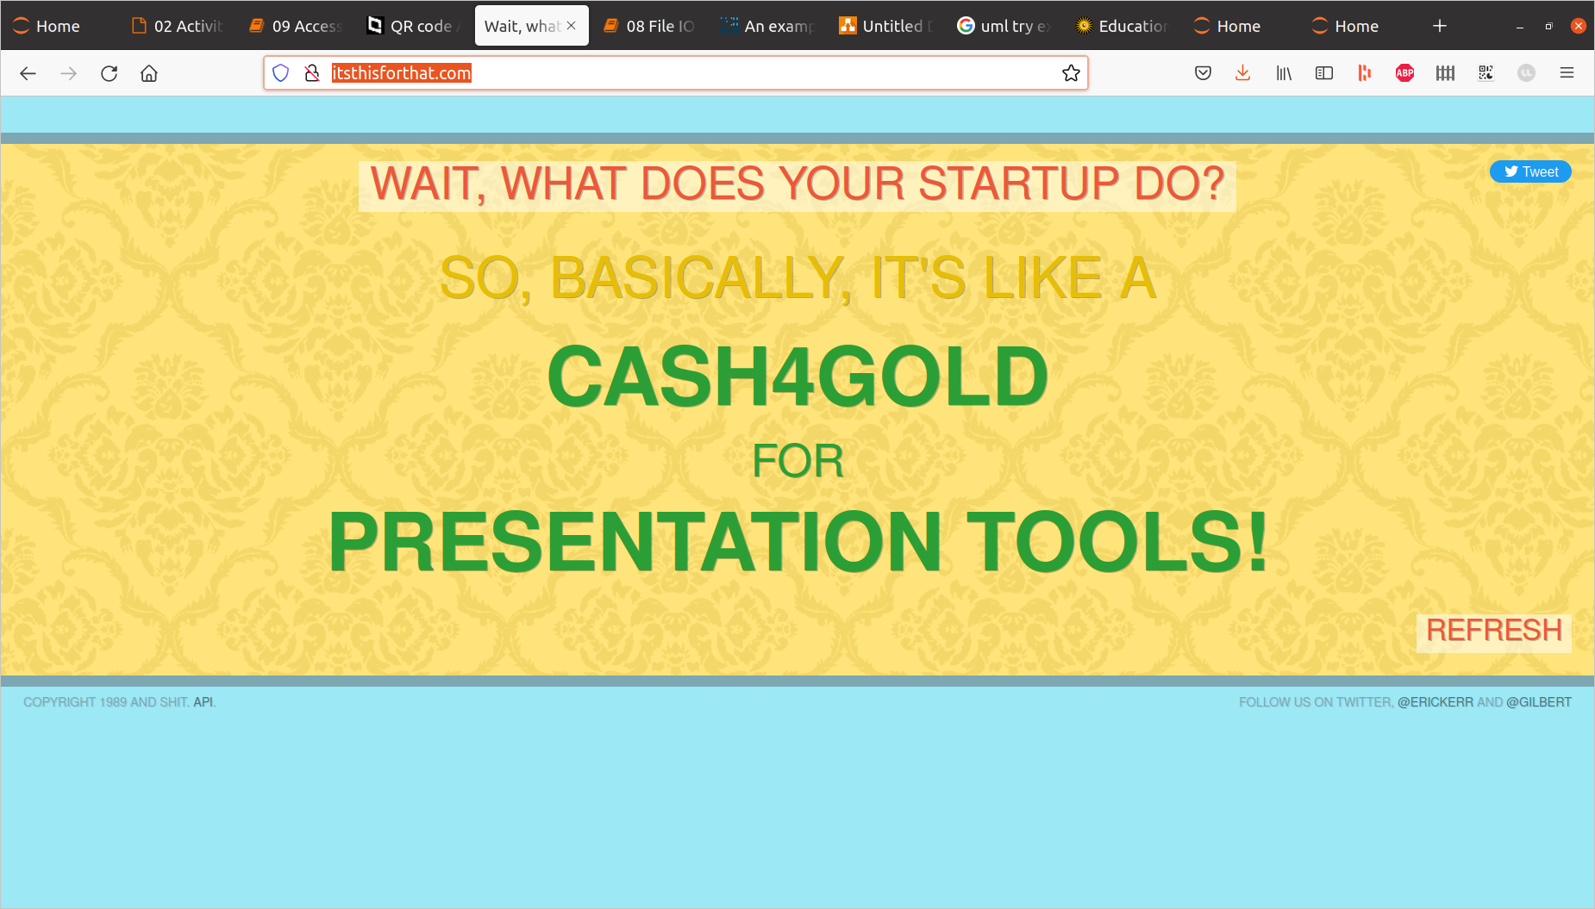
Browser Access

Slide 23
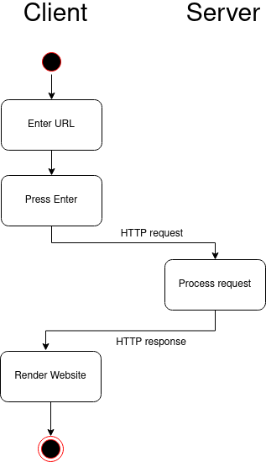
Browser Access

Slide 24
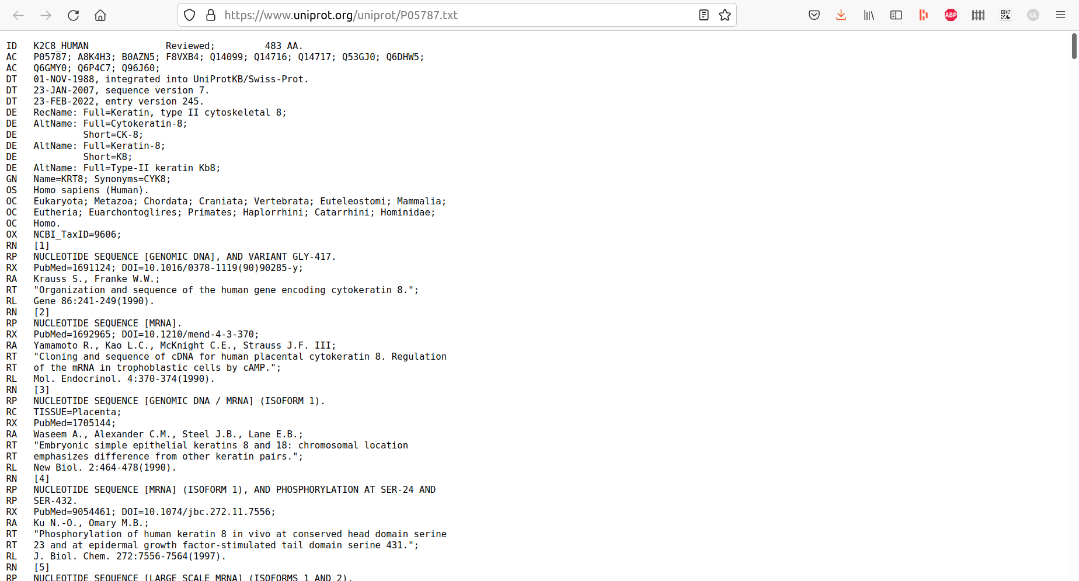
Browser Access

Slide 25
HTTP
Server
Request
Response

Slide 26
HTTP: GET

Slide 27
HTTP: GET
Server
Request
Response
Request = URL

Slide 28
HTTP: POST
Server
Request
Response
Request = URL + ...
Why would you want to send content?

Slide 29
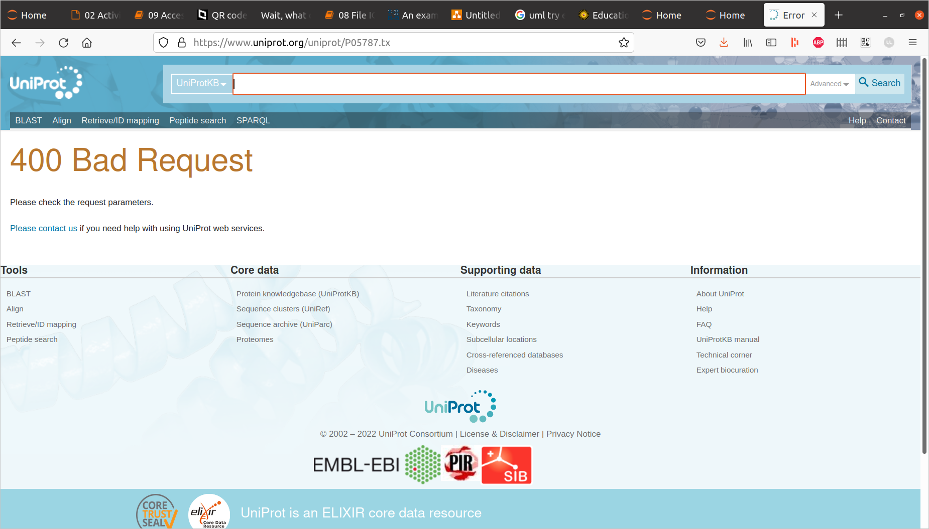
HTTP Response
* Response Code

Slide 30
HTTP Response
* Response Code:
1XX-3XX good, 4XX-5XX bad

Slide 31
HTTP Response
* Response Code:
1XX-3XX good, 4XX-5XX bad
* Response Content

Slide 32
HTTP Response
* Response Code:
1XX-3XX good, 4XX-5XX bad
* Response
Content:

Slide 33
Quick Recap
You want to analyze the average household income by municipality in NL
Amsterdam 31400
Amsterdam 31400
Delft 32100
Epe
Zeist 39700
What is the remaining challenge?

Slide 34
HTTP Response
* Response Code:
1XX-3XX good, 4XX-5XX bad
* Response
Content

Slide 35
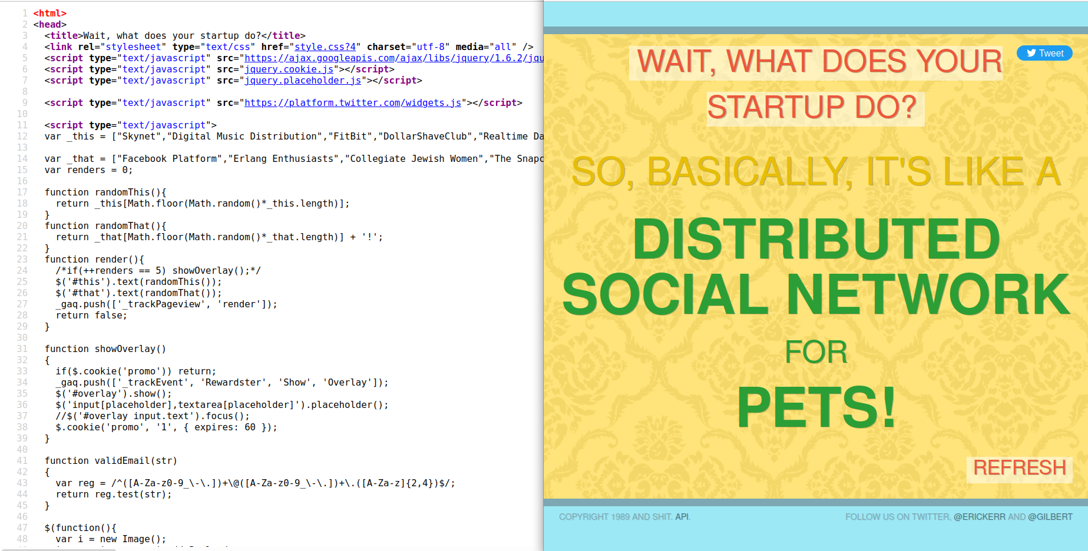
HTML

Slide 36
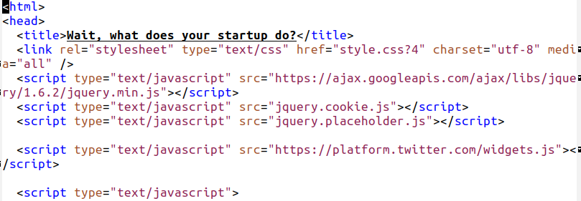
HTML

Slide 37
XML
<note>
<to>Tove</to>
<from>Jani</from>
<heading>Reminder</heading>
<body>Don't forget me this weekend!</body>
</note>

Slide 38
JSON
{"menu": {
"id": "file",
"value": "File",
"popup": {
"menuitem": [
{"value": "New", "onclick": "CreateNewDoc()"},
{"value": "Open", "onclick": "OpenDoc()"},
{"value": "Close", "onclick": "CloseDoc()"}
]
}
}}

Slide 39
Parsing
Parser
HTML, XML, JSON, etc
str, dict, list, pandas.DataFrame, etc.

Slide 40




Slide 41
To Do
Exercises for the week
  Use Quarterfall to submit them
Work on Project 2
Practice on Mastery Grids
Ask questions!

Slide 42
Next lecture
CRISP-DM
  Standard process for data mining
Python Data Science libaries
  Pandas
  NumPy
  Matplotlib

